Slide 1
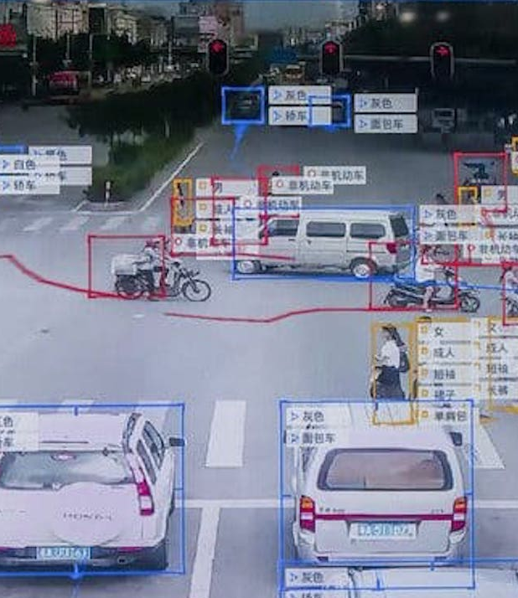
AI between assistance and surveillance
CT5142 Ethics and AI, Week 6

Slide 2

Surveillance
„close watching over“
traditionally targeted at specific individuals, especially those suspected of crimes or objectionable behaviour
Information technology and AI raising new concerns regarding the facilitation of new modes of surveillance, with wider reach and increasing intimacy

Slide 3
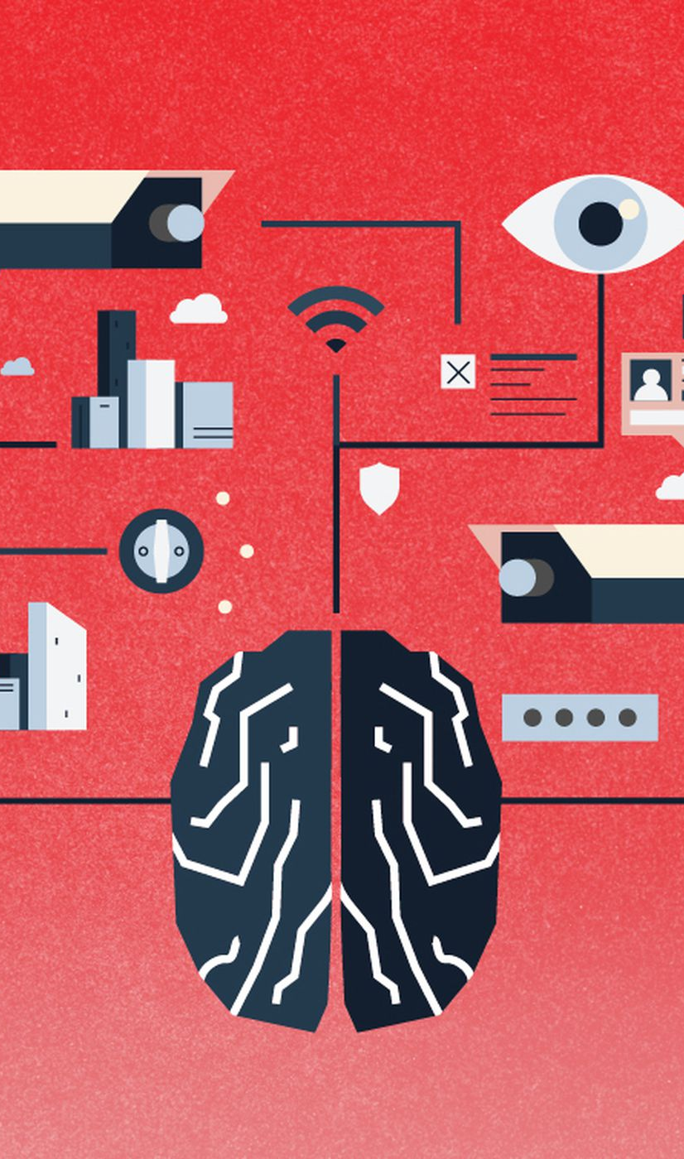
Surveillance, co-veillance and self-surveillance
Surveillance, i.e. observing by third parties, with aim to keep track of, potentially control and discipline others
Co-veillance, i.e. observing by peers in a community, with attempts to influence behaviour of peers
Self-surveillance, i.e. observing and trying to control oneself

Slide 4
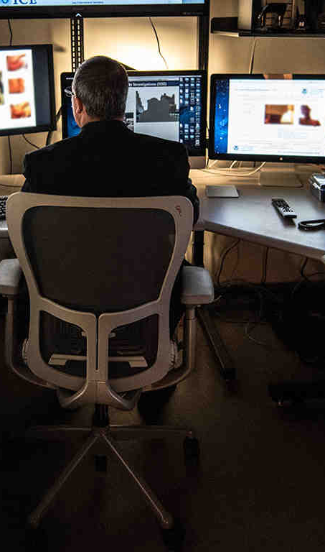
Adversarial vs non-adversarial surveillance
Adversarial surveillance:
Personal surveillance
Mass surveillance
Sous-veillance („watching from below“, trying to hold authorities to account by tracking their behaviour)
Non-adversarial surveillance:
Peer surveillance or co-veillance (but incl. public shaming)
Self-surveillance
Protective surveillance of vulnerable groups

Slide 5
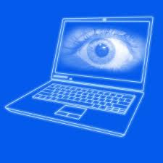
Dataveillance
Collection of continuous stream of online data and metadata
Challenge of merging data from different platforms and tracing digital footprints
Often happening without data subjects‘ awareness
Can be used to identify and track individuals (personal dataveillance) or groups with certain characteristics (mass dataveillance), either to identify relevant characteristics or as precursor to formal surveillance

Slide 6

Examples of everyday surveillance
Monitoring of certain parameters of employee behaviour throughout the working day (or even outside)
E.g. Amazon Warehouses: GPS trackers and performance metrics
Fitbits to monitor employees‘ health behaviour
Surveillance of vulnerable populations by government bodies
E.g. through increasing AI assessment and processing of social security entitlements (UK)
Algorithmic child protection monitoring decision-making (Algheny County, NY)
AI assisted policing, e.g. face recognition in South Wales
Surveillance of vulnerable populations in private settings
Ambient assisted living (AAL) for older persons
Nannycams in childcare

Slide 7
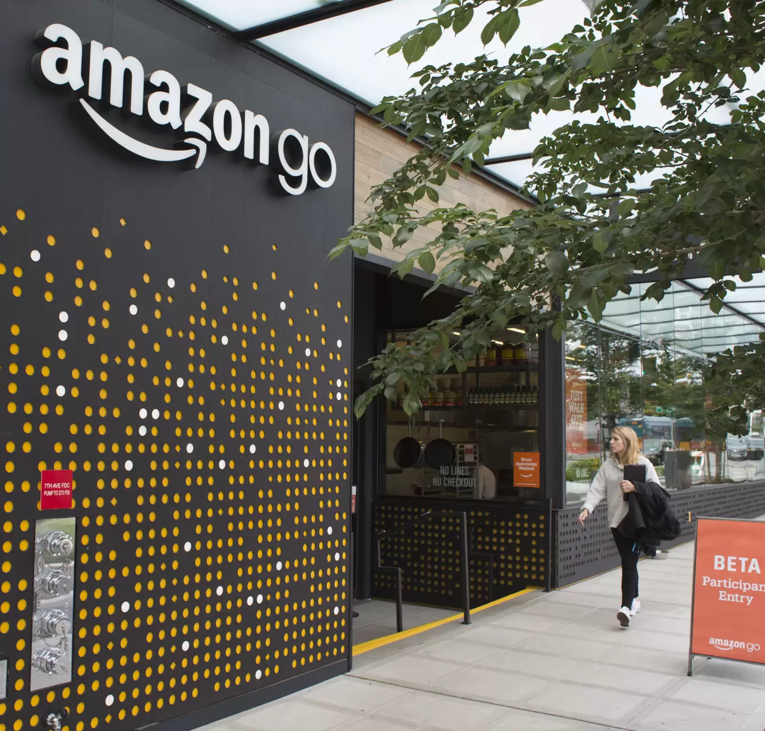
Amazon Go shops: surveillance and convenience
Convenience as core selling point for cashier-less „Just walk out“ experimental amazon go shops
User downloads app and their activity in shop is captured by hundreds of cameras and analysed with regard to various commercial purposes

Slide 8
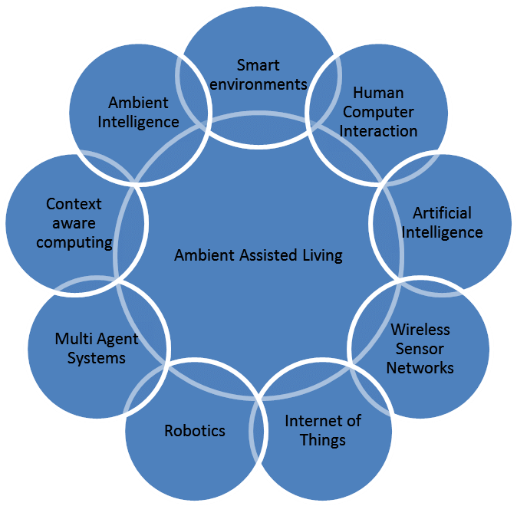
Ambient assisted living: AI assistance and surveillance
AI promises to provide high quality surveillance with reduced human burden
Combination of various sensors and data sources
E.g. Ambient Assisted Living envisaged as smart home technology that supports frail persons in performing everyday tasks while also monitoring their safety and well-being, via observation cameras, functional assessments, reminder and instruction systems, self-monitoring fridge with order function, links with health record or carer records etc.

Slide 9
The spread of AI surveillance technology
2019 Carnegie Endowment report:
75 countries globally actively use AI for surveillance purposes, including smart city/safe city platforms (56), facial recognition (64) and smart policing (52)
Chinese companies as worldwide drivers of surveillance technology
But democratic countries as major users of AI surveillance (51% of democratic countries, more than autocratic states), with little monitoring and controlling spread
https://carnegieendowment.org/files/AI_Global_Surveillance_Index1.pdf
https://carnegieendowment.org/2019/09/17/global-expansion-of-ai-surveillance-pub-79847

Slide 10
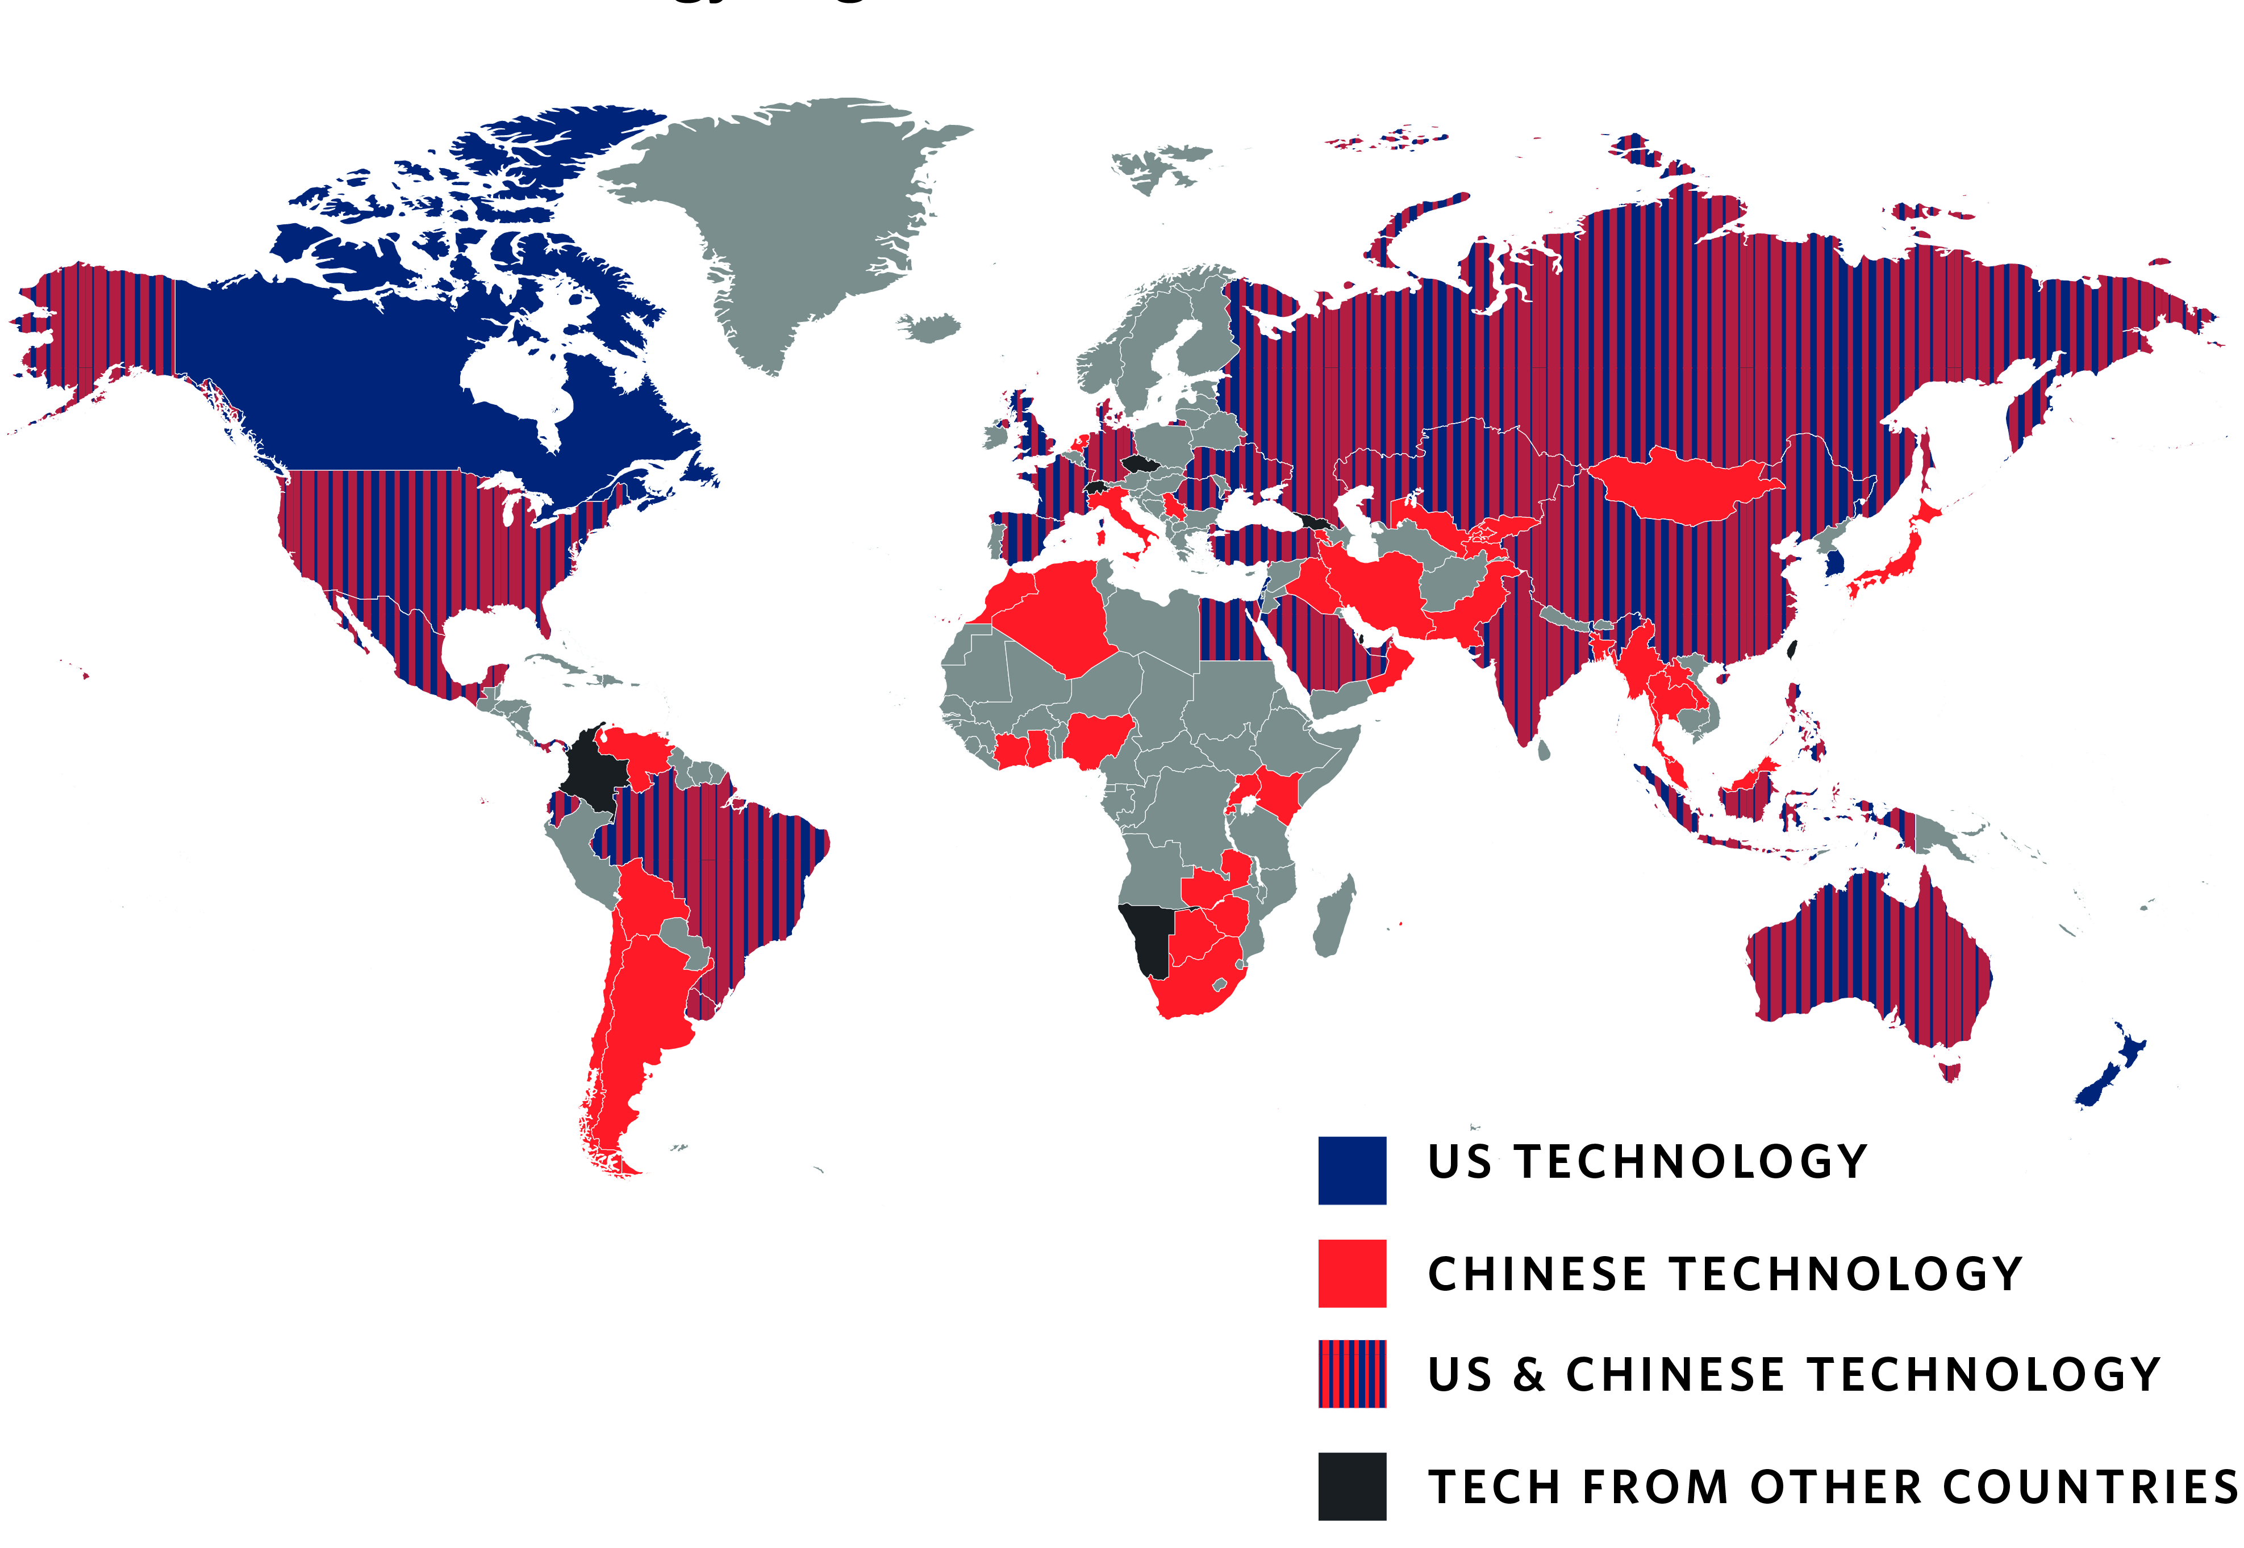

Slide 11
What does AI add to traditional surveillance?
Reduced reliance on human observation, with resulting lower cost and easy scalability (depending on hardware required)
Complex analysis of captured information, drawing inferences and making predictions
Promises to improve levels of accuracy and decrease effect of irrational elements of decision-making (promise and reality may not always match)
Might allow real-time adaptation to complex set of parameters

Slide 12
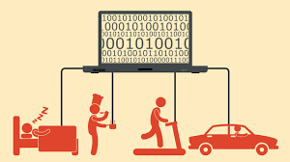
Ethical Challenges of digital assistance/surveillance

Slide 13
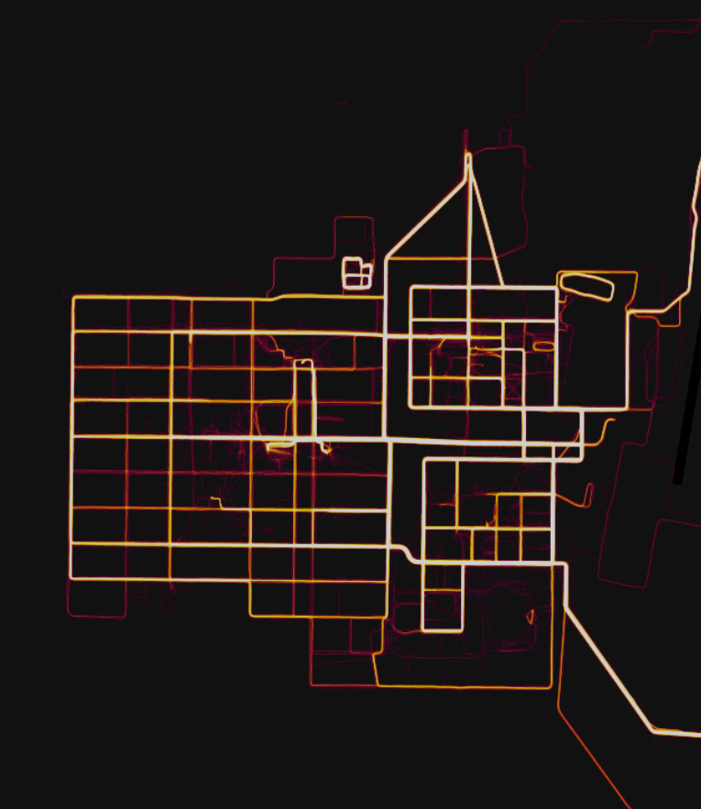
Unwitting disclosures through aggregate data
2018: Strava Fitness tracker made public heatmaps of aggregated activity routes of Strava users
This identified the location of secret US military bases, e.g. in Afghanistan
(This was merely simple aggregation – how about more complex analysis of hidden features?)

Slide 14
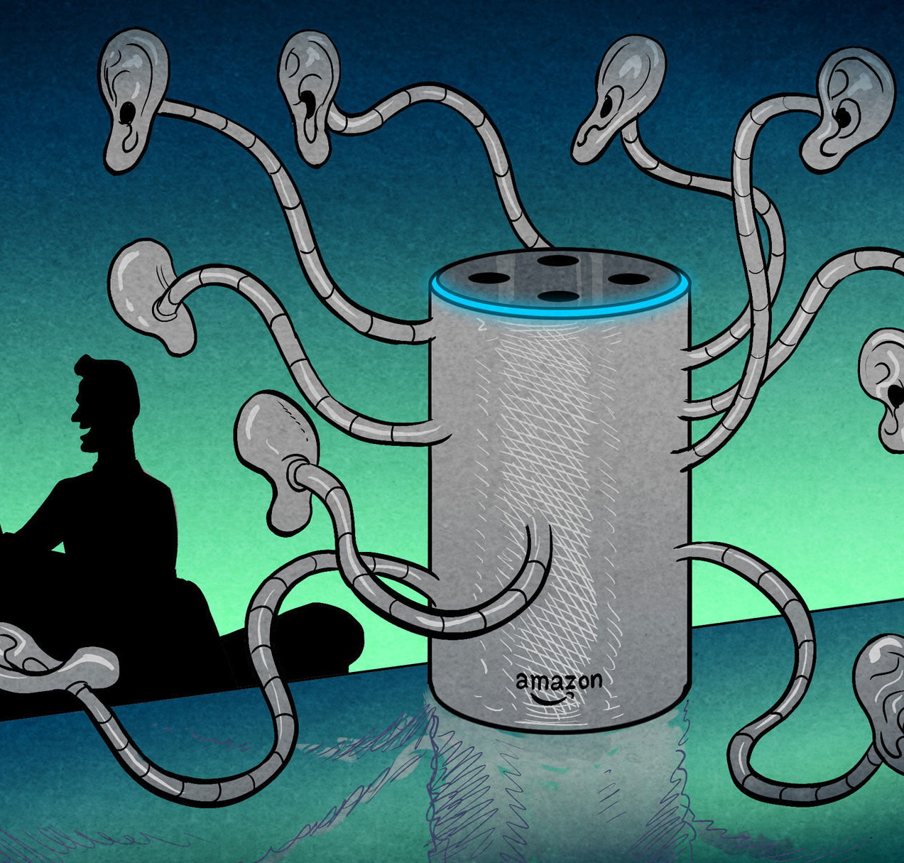
„Always-on“ monitoring through personal devices
E.g. Fitness trackers or health apps for mobile phones
E.g. Alexa as voice assistant that is „always on standby“, reacts to wake-up word
Integrated with Amazon and wide range of other services
Range of problems associated with potential unintended capturing of information and use by third parties

Slide 15
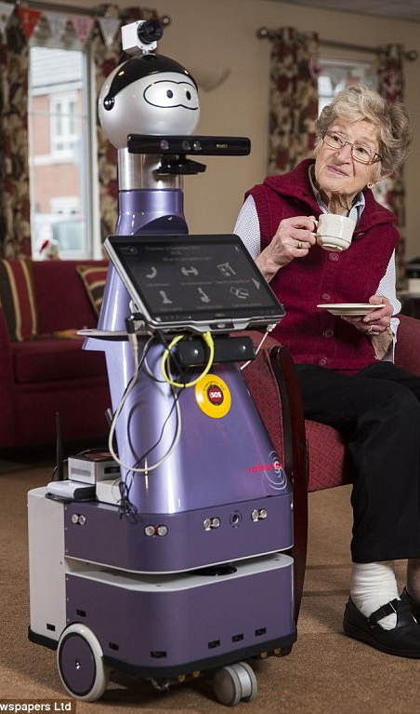
Intrusiveness of monitoring and assistance for vulnerable persons
Surveillance in care contexts often for vulnerable persons, e.g. older person, children, persons with disabilities
may be perceived as intrusive and undignified by users
Users‘ demand for an off-button
Personal sense of dignity and private space needs to be respected, especially when used in domestic or residential settings

Slide 16
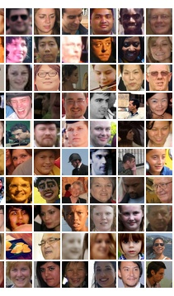
Unwitting contribution to AI training datasets
Alexa and Siri: initially creation of random human transcripts without explicit consent
Facial recognition systems include large numbers of openly available photos, often geotagged and account-linked
E.g. Megaface from Flickr (4 mio photos from over 670,000 people)
If opt-out is available, it is burdensome and not necessarily effective
“Who could have possibly predicted that a snapshot of a toddler in 2005 would contribute, a decade and a half later, to the development of bleeding-edge surveillance technology?” – contextual integrity

Slide 17
Unavoidability of surveillance through obligatory services
Example: the mandatory use of certain products in education, e.g. VLEs like Blackboard in Higher Education; use of tracking systems on school computers; use of integrated system of Google Classroom
See recent Danish case (2022): A Danish City Built Google Into Its Schools—Then Banned It | WIRED
See Human Rights Watch report (2022): https://www.hrw.org/report/2022/05/25/how-dare-they-peep-my-private-life/childrens-rights-violations-governments

Slide 18
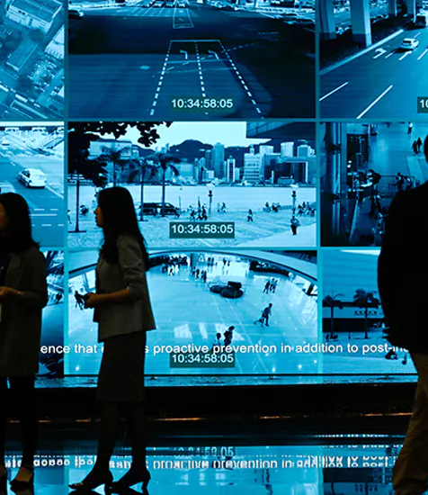
Indiscriminateness of dataveillance and „automated suspicion“
Ethical concern that wide net is cast and many people end up under surveillance without good reason
Problem: no clear differentiation between suspects and ordinary people
justifying mass surveillance on basis of potential results
But: direct and indirect privacy harms?

Slide 19
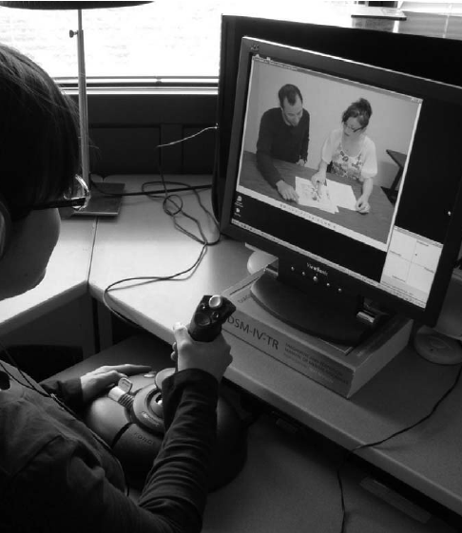
Potential 3rd party uses of tracking data
Captured data is potentially of interest to variety of bodies
Potential purposes could include:
Targeted advertising
Scrutiny by police
Assessment by system of social services
Insurance risk assessment
Screening of potential employee qualities
Behavioural change

Slide 20
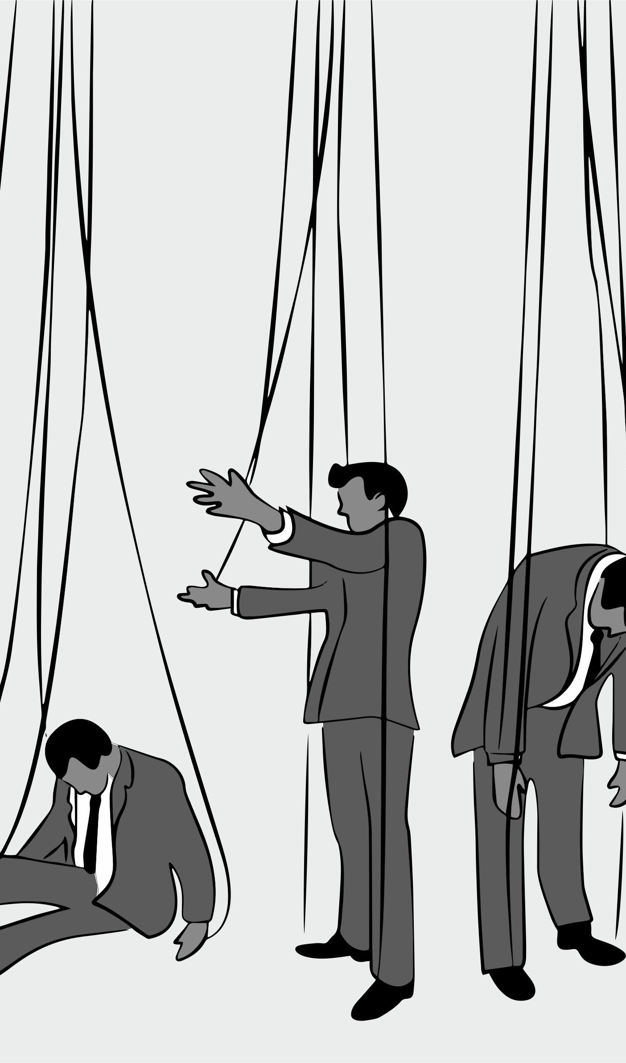
“Pushed” self- tracking (Lupton)
self-tracking in response to requests (or demands) by third parties
Particularly problematic if third parties have an interest in the information that does not correspond to users’ interests, and they get access to the information in power relationship or manipulatively
E.g. insurance companies asking for access to fitbit data in return for reduced insurance rates
employer providing extra benefits in return for tracking
health apps getting more commercially valuable data when different data sources are combined by users

Slide 21
How to keep surveillance ethical?

Slide 22

Macnish (2017): Ethical criteria for legitimate surveillance
Surveillance needs to be based on good and openly shareable reasons
Level of surveillance needs to be proportionate to goals
Surveillance needs to discriminate between “innocents” and targets (i.e. vs. mass surveillance)

Slide 23

Some additional requirements for responsible use of surveillance data
Strong security measures need to be implemented
Including preventing liquidation sales of data for new purposes
Transparency regarding data uses (notice & consent)
Provide privacy options, including “right to be forgotten”/option to delete data
“Data selling” practices need to be transparent

Slide 24
Concerns listed in 2022 FTC Consultation on commercial surveillance
Need for appropriate security measures
Avoidance of potential current or future harms to children
Avoidance of “coercion” of people into surveillance as condition of services
Surveillance creep through changing privacy policies with expanding surveillance
Need for ensuring accuracy of surveillance data and inferences drawn from it
Need to address the problem of bias
Avoidance of dark patterns that trick users into sharing information
https://www.ftc.gov/system/files/ftc_gov/pdf/Commercial%20Surveillance%20and%20Data%20Security%20Rulemaking%20Fact%20Sheet_1.pdf

